Slide 1

English

Slide 2
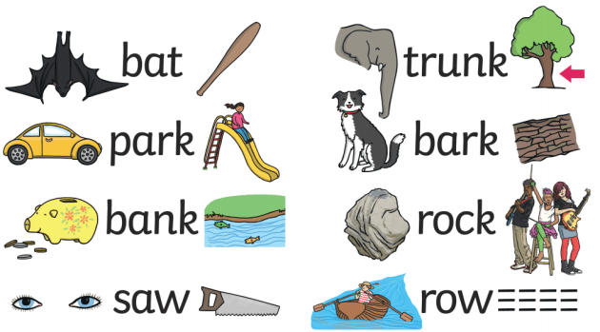
HOMOPHONE AND HOMONYM
HOMO MEANS SAME
Homophone  (Phone = sound)
Words that sound the same but have different spellings
Example: Hole / whole – Right /write – Cite/Site
Homonym  (Nym = Name)  Pseudonym = fake name
Words that sound the same and have the same spellings
Example:
–

Slide 3
ANALOGY
An analogy is a comparison between two things, and the comparison is used to determined the relationship between different sets of things
Example
Life is like a race. The one who keeps running wins the race and the one who stops to catch a breath loses.
Just as a sword is the weapon of a warrior, a pen is the weapon of a writer.
How a doctor diagnoses diseases is like how a detective investigates crimes.

Slide 4
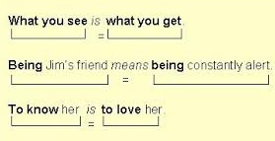
PARALLELISM
Parallelism is the use of components in a sentence that are grammatically the same; or similar in their construction, sound, meaning or meter.
Example
Like father, like son.
Easy come, easy go.

Slide 5
INITIALISM AND ACRONYM
ACRONYMS AND INITIALISMS ARE TWO TYPES OF ABBREVIATION THAT TYPICALLY CONSIST OF THE FIRST LETTER OF EACH WORD IN A PHRASE

Slide 6
INITIALISM
Initialisms are abbreviations created by using the first letters of each word in a phrase. However, initialisms are pronounced as a list of letters, not as a word:
Example:
BBC - British Broadcasting Corporation
FBI - Federal Bureau of Investigation)
–

Slide 7
ACRONYM
An acronym is an abbreviation of a phrase created by using the first letter of each word (or some of the words) in the phrase.
Example:
NATO - North Atlantic Treaty Organization
RADAR - Radio Detection and Ranging
–

Slide 8
ONLINE COMMUNICATION
THE EXCHANGE OF INFORMATION USING THE INTERNET OR A MOBILE COMMUNICATION NETWORK FOR ANY PURPOSE IS ONLINE COMMUNICATION.
TYPES OF ONLINE COMMUNICATION:
Video Conferencing
Chats
Emails ·
Social Networks

Slide 9
ASYNCHRONOUS AND SYNCHRONOUS COMMUNICATION
SYNCHRONOUS COMMUNICATION happens in real time, where at least two individuals are exchanging information, at the same time with each other.
Example: In-person meeting, Phone call, Video conference, Coffee break conversations
ASYNCHRONOUS COMMUNICATION happens not in real-time, where there is generally a time gap between sender and receiver.
Example: Email, Letters, Text messaging

Slide 10
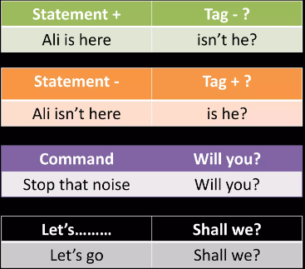
FRAMING QUESTION TAGS
A Question Tag is a Short Question at the end of a Statement
Generally, question tag used to check if information is correct or not
Rules:
Auxiliary VERB + PRONOUN.
I shouldn’t laugh, Should I?
Sarah was winning, wasn’t she?
Example

